Slide 1
Data Structures
ICT-1211
Information and Communication Technology
Lecture-15
Date: //2024

Slide 2
Linked Lists

Slide 3
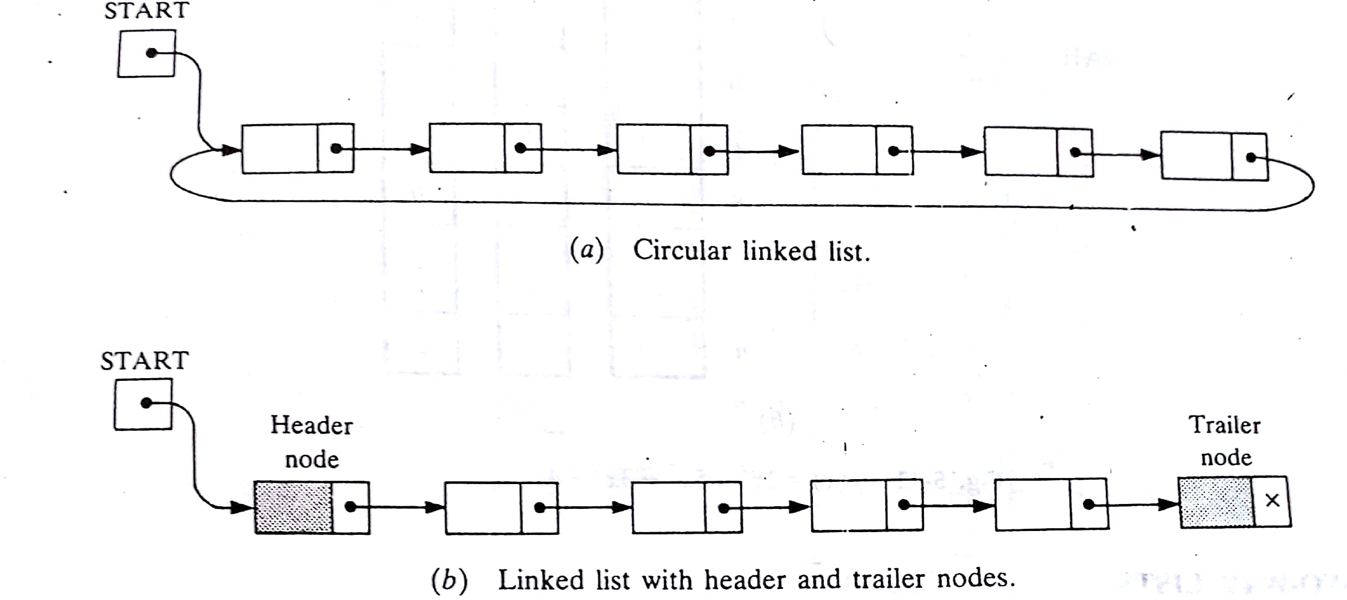
TWO other variations of LINKED LIST
A linked list whose last node points back to the first node instead of containing the null pointer, called a circular list.
A linked list which contain both a special header node at the beginning of the list and a special trailer node at the end of the list.

Slide 4
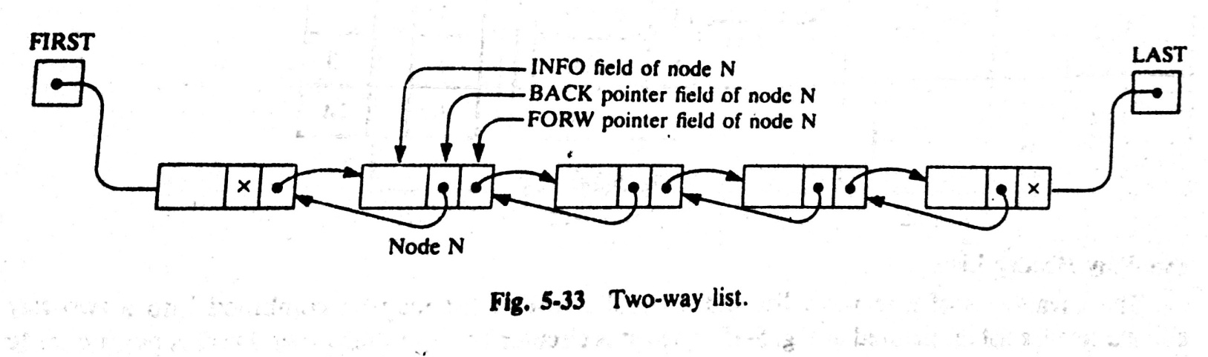
TWO-WAY LISTS:
A two-way list is a linear collection of data elements, called nodes, where each node N is divided into three parts:
An information field INFO which contains the data of N
A pointer field FORW which contains the location of the next node in the list
A pointer field BACK which contain the location of the preceding node in the list.

Slide 5
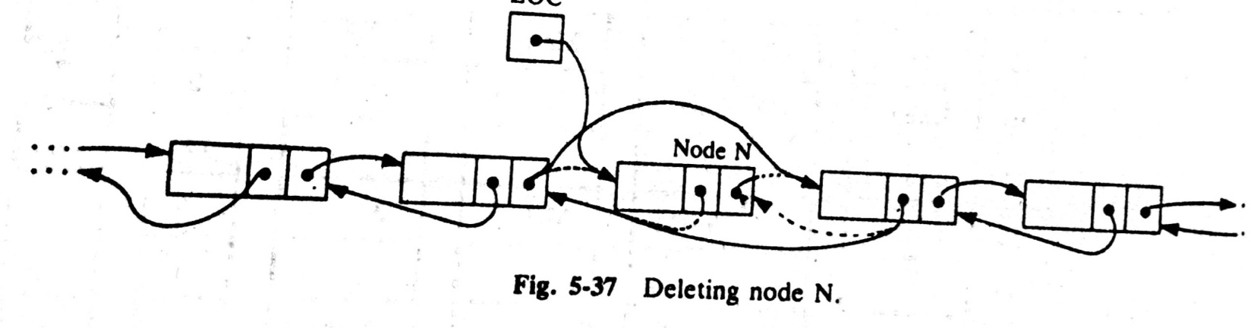
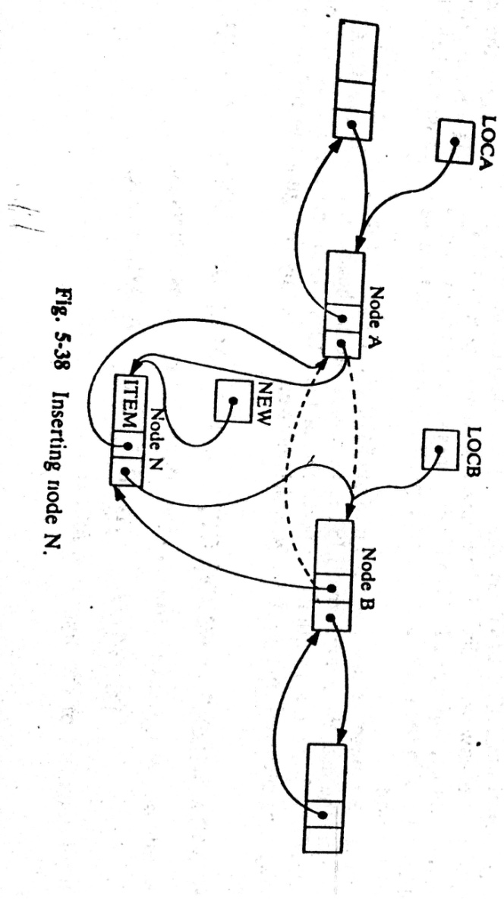
TWO-WAY LISTS: Operations
Deleting:
Inserting:

Slide 6
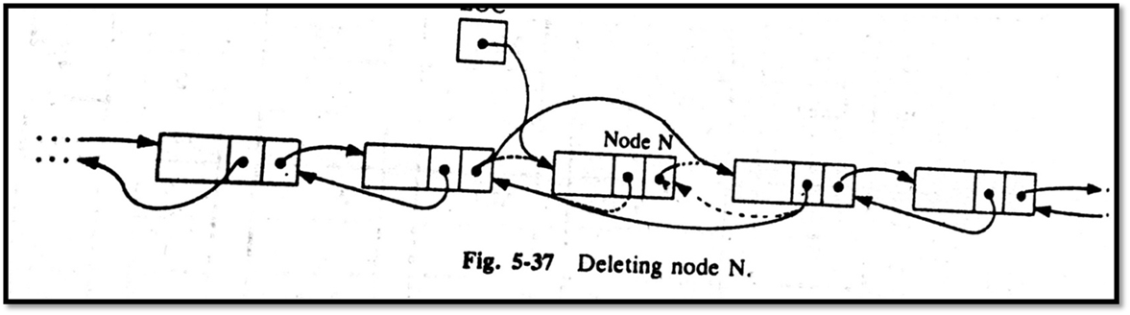
Two way Linked LISTS: Delete
FORW [BACK [LOC] ] : = FORW [LOC] and
BACK [FORW [LOC] ] : = BACK [LOC]
The deleted node N is then returned to the AVAIL list by the following assignment:
FORW [LOC] : = AVAIL and AVAIL : = LOC

Slide 7

Two way Linked LISTS: Delete
DELTWL (INFO, FORW, BACK, START, AVAIL, LOC)
(Deletes the node N from List.)
Step1. [Delete node]
Set FORW [BACK [LOC] ] : = FORW [LOC] and
Set BACK [FORW [LOC] ] : = BACK [LOC]
Step2. [Return node to Avail List ]
Set FORW [LOC] : = AVAIL and AVAIL : = LOC
Step3. Exit
Deleting:

Slide 8
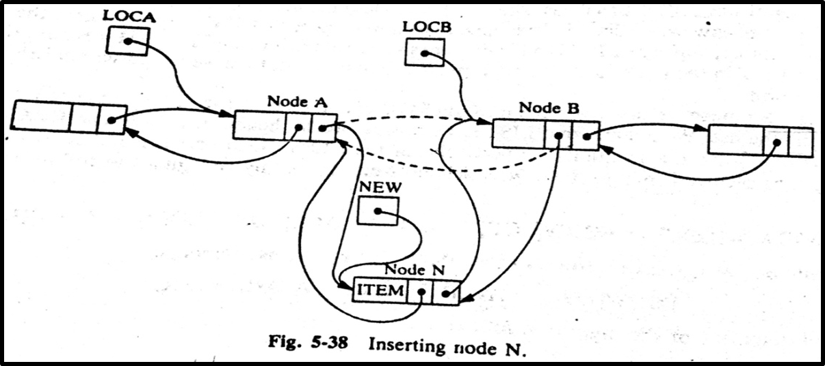
Two way Linked LISTS: Insert
NEW : = AVAIL, AVAIL : = FORW [AVAIL], INFO [NEW] : = ITEM
Then
FORW [LOCA] : = NEW, FORW [NEW] : = LOCB
BACK [LOCB] : = NEW, BACK [NEW] : = LOCA

Slide 9
Two way Linked LISTS: Insert
INSTWL (INFO, FORW, BACK, START, AVAIL, LOCA, LOCB, ITEM)
(Insert the node N to the List.)
Step1. [OVERFLOW?]
If AVAIL := NULL, then: Write: OVERFLOW, and Exit.
Step2. [Remove node from AVAIL list and copy the new data into node]
Set NEW := AVAIL , AVAIL := FORW [AVAIL], INFO [NEW]:= ITEM
Step3. [Insert node into list.]
Set FORW [LOCA ] : = NEW, FORW [NEW] : = LOCB,
BACK [LOCB] : = NEW, BACK [NEW] : = LOCA
Step4. Exit

Slide 10
Thank you……

